Slide 1
Digital Bank Demo Application
Team Lead – M.Sohail 2587105
Team – Siddhesh 2587288
R.Himabindu 2587303
Selvakumar 2587291
Matani Ritheesh 2587211
Konda Vinisha 2587235
Sadiq Ali 2587194
Krishna B A 2587049
Under the Guidance of:
Suvitha Perumal

Slide 2
Table Of Content:
Introduction
Technologies used
Modules – Test cases
Conclusion

Slide 3
Digital Demo Bank Feature:
It is a simulated bank that allows you to test Tink products without using real bank credentials.
This site has many features which include Depositing money into your account withdrawing money from your account and transferring money from one account to another account it also has features such as saving accounts and checking accounts.
We can see the total amount in our account also.

Slide 4
Automation Testing
Automation testing is a process of using specialized software tools to automate the execution of tests.
It helps in improving the efficiency and effectiveness of software testing
Automation testing significantly speeds up the testing process by executing test cases much faster than manual testing.
Automation testing eliminates the potential for human error that comes with manual testing, ensuring more accurate and consistent test results.

Slide 5
Technologies Used
Selenium
Cucumber
TestNG
IRetryAnalyzer
ITestListener
Logs
JIRA
Extent Reports

Slide 6

1. Selenium
Selenium: an open-source tool for automating web browsers.
Initially developed by Jason Huggins in 2004.
Supports multiple programming languages: Java, Python, C#, etc.
Key Components:
Selenium IDE
Selenium WebDriver
Selenium Grid
Selenium is very extensible and can be integrated with other tools and frameworks like TestNG, JUnit, Cucumber, etc.

Slide 7
Advantages
Supports multiple browsers: Chrome, Firefox, Safari, etc.
Supports multiple operating systems: Windows, macOS, Linux, etc.
Language flexibility: write tests in Java, Python, etc.
Large community support and active development.
Enables faster testing cycles and better coverage.
Cost-effective compared to commercial automation tools.
Improves testing accuracy and reduces human errors.

Slide 8

2. Cucumber
Cucumber is a popular open-source testing framework used for behavior-driven development (BDD). It allows you to write automated tests in a natural language format, which can be easily understood by non-technical stakeholders. Cucumber facilitates collaboration between developers, testers, and business stakeholders by providing a common language for defining and verifying application behaviour.
How Cucumber is used for Automation?
Cucumber helps in automation testing by allowing the creation of executable specifications in a human-readable format called Gherkin. It promotes collaboration between team members and ensures that tests accurately reflect the desired behaviour of the application.

Slide 9
Features
Gherkin Syntax: Cucumber tests are written using the Gherkin syntax, which is a human-readable format for defining test scenarios. Gherkin features descriptive keywords such as Given, When, Then, And, and But to structure scenarios.
Scenario Outlines: Cucumber supports scenario outlines, allowing you to run the same scenario with multiple sets of data. This facilitates data-driven testing.
Step Definitions: Test steps defined in feature files are mapped to step definitions written in programming languages like Java, Ruby, or JavaScript. Step definitions contain the actual automation logic to execute the steps.
Tagging: Cucumber allows you to tag scenarios with labels for better organization and execution control. Tags can be used to group related scenarios or to run specific subsets of tests.
Reports: Cucumber generates detailed test reports, including information about test results, scenario statuses, and execution times. These reports help teams track test coverage and identify failures.

Slide 10
Scenario Outline
The Scenario Outline keyword can be used to run the same Scenario multiple times, with different combinations of values.
The keyword Scenario Template is a synonym of the keyword Scenario Outline.
Copying and pasting scenarios to use different values quickly becomes tedious and repetitive:
Feature: User Login
Scenario Outline: Valid Login with Different Credentials
Given the user is on the login page
When the user enters "<username>" and "<password>"
And clicks the login button
Then the user should be logged in successfully
Examples:
| username | password |
| sadiqali@gmail.com | Admin@1234

Slide 11
Advantages
Readable and Understandable Tests
Improved Collaboration
Data-Driven Testing
Cross-Platform Support
Test Reports and Documentation
Maintainability and Reusability

Slide 12

3. TestNG
What is TestNG?
TestNG is a popular testing framework for Java that allows users to perform automated testing for web applications. Selenium, on the other hand, is a popular automation testing tool that enables users to automate web browsers.
TestNG provides features for organizing test cases, running tests in parallel, generating test reports, and handling dependencies between test methods.

Slide 13
Advantages
Group test cases into logical units, making managing and maintaining your test suite easier.
Run tests in parallel, significantly reducing the time it takes to execute your test suite.
TestNG provides a wide range of annotations that you can use to customize your tests, such as @BeforeSuite, @AfterSuite, @BeforeTest, @AfterTest, @BeforeMethod, and @AfterMethod.
It supports data-driven testing, allowing you to run the same test case with multiple test data sets.
Better reporting and logging features than other testing frameworks make identifying and debugging issues in your tests easier.

Slide 14
Implementation
TestNG can be implemented by creating test classes with test methods annotated with @Test, configuring test suites, and using annotations like @BeforeMethod and @AfterMethod for setup and teardown operations.
Utilize TestNG's parameterization features to run the same test method with different sets of data. You can use @DataProvider or @Parameters annotations to supply test data to your test methods.
Generate test reports using TestNG's built-in reporting capabilities. TestNG generates detailed HTML reports with information about test results, including pass/fail status, execution time, and stack traces for failed tests.

Slide 15

3.1 IRetryAnalyzer
When does Automation script fails?
1.Server down
2.Network slowness
3.Application might be slow
It is an interface in TestNG that allows you to implement custom logic for retrying failed test cases. By implementing this interface, you can specify how many times a test should be retried before marking it as a failure. This is useful for handling tests that occasionally fail due to external factors.

Slide 16
Advantages
Re-running flaky tests
Handling transient errors
Reducing false positives
Improved test stability

Slide 17
3.2 ITestListener
It is a testing frameworks like TestNG or JUnit enable customizing test execution behavior, such as logging or reporting, without modifying test code, by providing interfaces or classes for actions at different stages of the test lifecycle.
Why iTestListeners are Used?
iTestListeners is commonly used in test automation frameworks, particularly with TestNG or similar testing frameworks. The primary purpose of iTestListeners is to provide a mechanism for listening to and responding to events that occur during the execution of test cases.

Slide 18
Advantages
Real-time Monitoring
Automated Response
Customization
Integration
Dynamic Configuration

Slide 19

3.3 Logs
Understanding Log4j2
Log4j2 is the updated version of the popular and influential log4j library
It's a tool that helps software developers keep track of what their programs are doing
Logging is highly flexible, and you can set it to monitor various levels of log event severity, such as all (all messages), debug, info (important/informative messages), warn, error, off, and fatal. Log4j can manage Java exceptions in your code.
Log4j2 uses a plugin system where we can define custom appenders, filters and Layouts.
Main parts configuration, appenders, Console, Loggers.
the framework gives out information about everything that goes on during the test case execution. Log4j also provides insight into anything that may have gone wrong during test case execution or automation

Slide 20
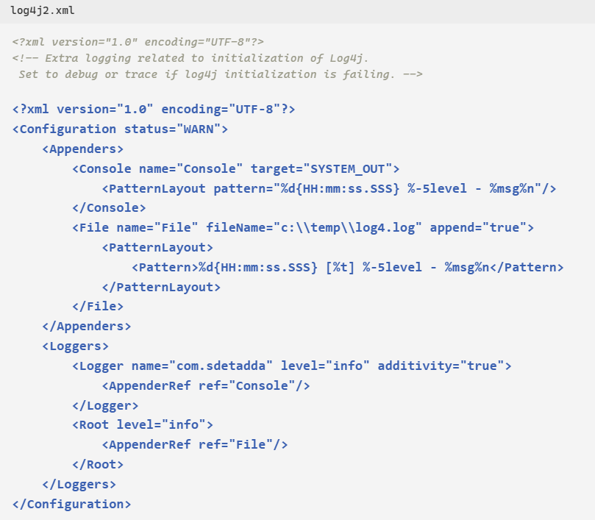
Basic Log4j2 Configuration
log4j-core/2.19.0 in Pom.xml
log4j-api/2.19.0
private static Logger logger = LogManager.getLogger(MyService.class);
Standard Level | intLevel
OFF | 0
FATAL | 100
ERROR | 200
WARN | 300
INFO | 400
DEBUG | 500
TRACE | 600

Slide 21
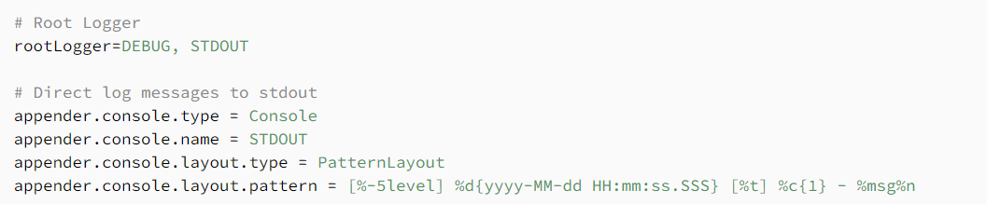
Parts of Log4J2
Configuration: the root element of a log4j2 configuration file; the status attribute represents the level at which internal log4j events should be logged Appenders: this element contains a list of appenders. Loggers: this element contains a list of Logger instances. The Root element is a standard logger that outputs all messages
Log4j logging framework can help in debugging applications easily. With different log levels, it becomes easier to sort information based on categories.
The setup is easy and free of cost, making it more accessible for faster debugging.
log4j2.properties:-

Slide 22
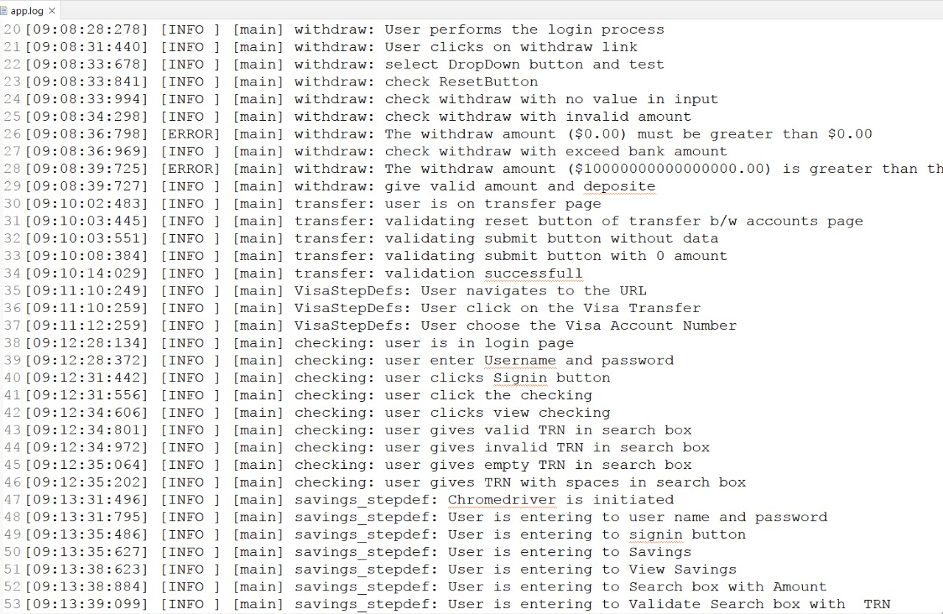
Log4J

Slide 23

4.JIRA
JIRA is a Project management tool
Jira is a popular project management and issue-tracking tool developed by Atlassian. It is widely used by teams to plan, track, and manage their work efficiently.
Terminologies:
1. Epic 2. Stories
3. Tasks

Slide 24
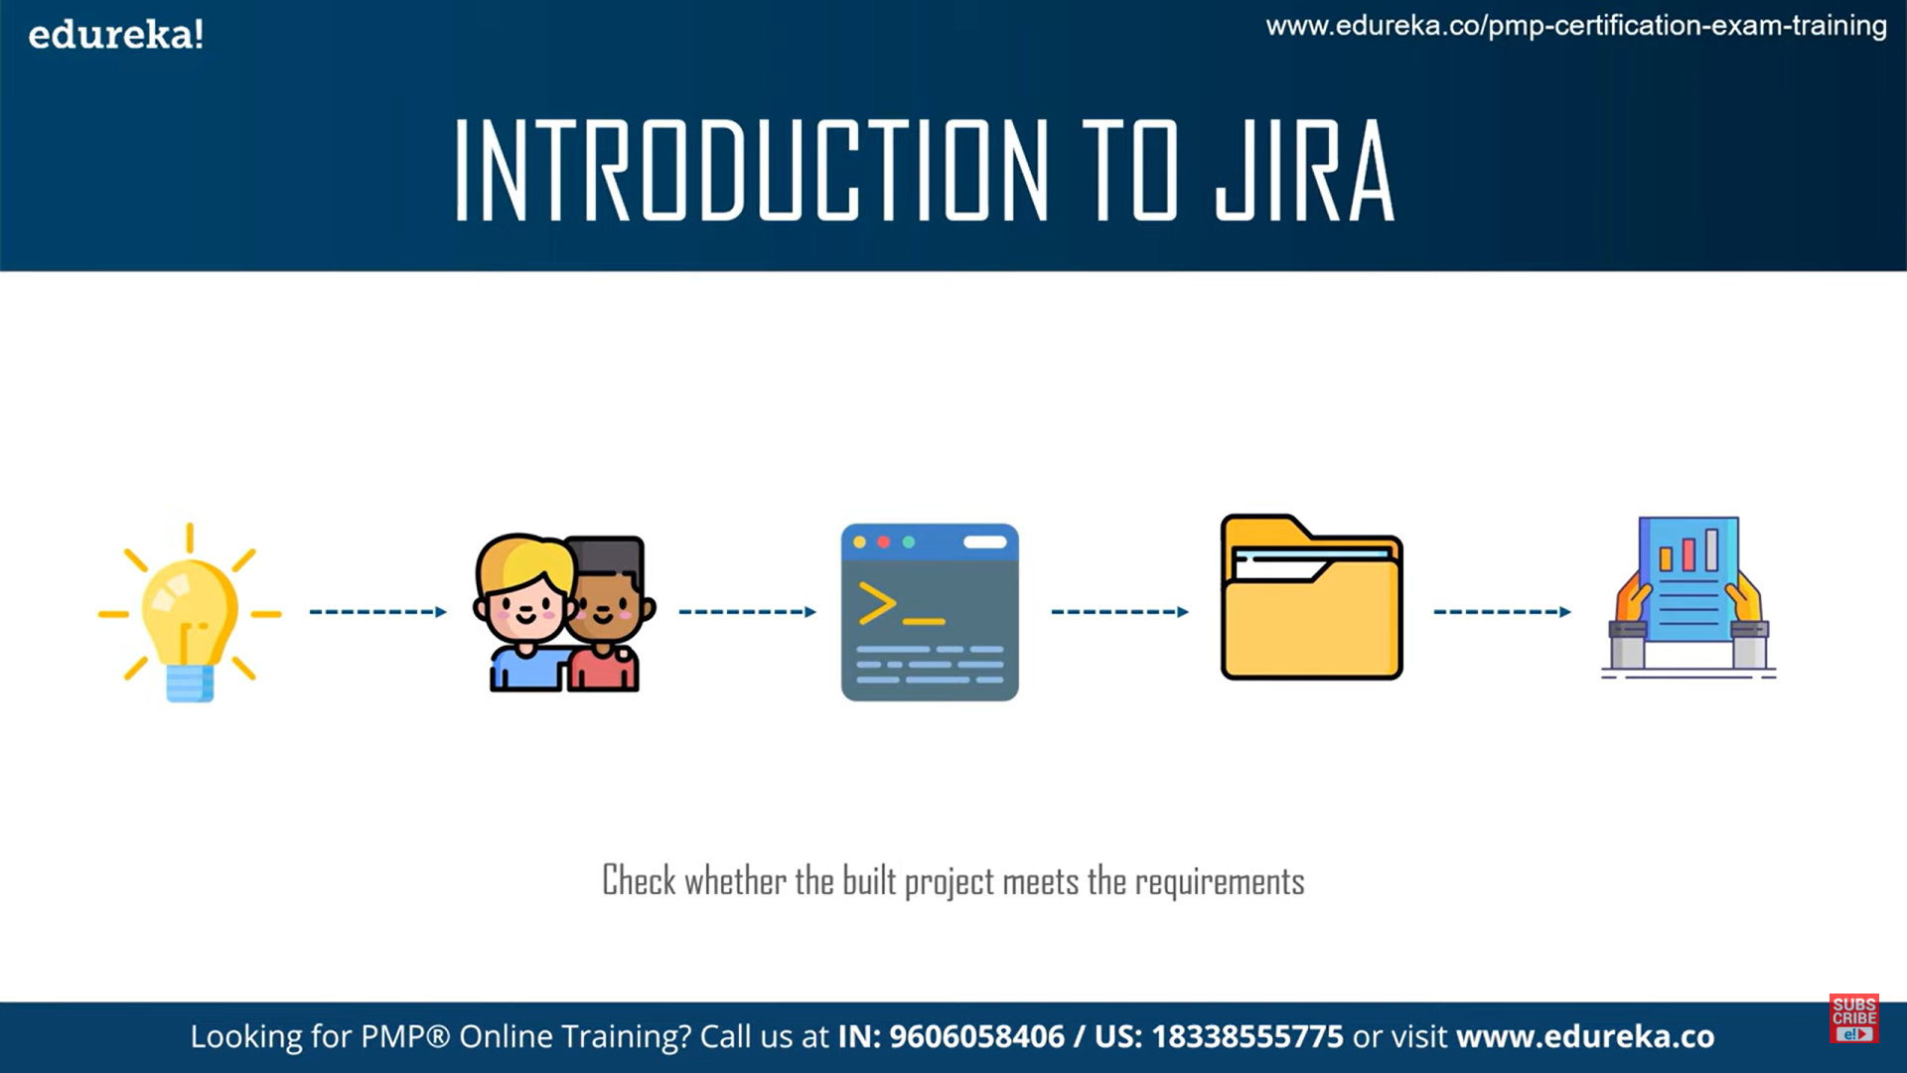
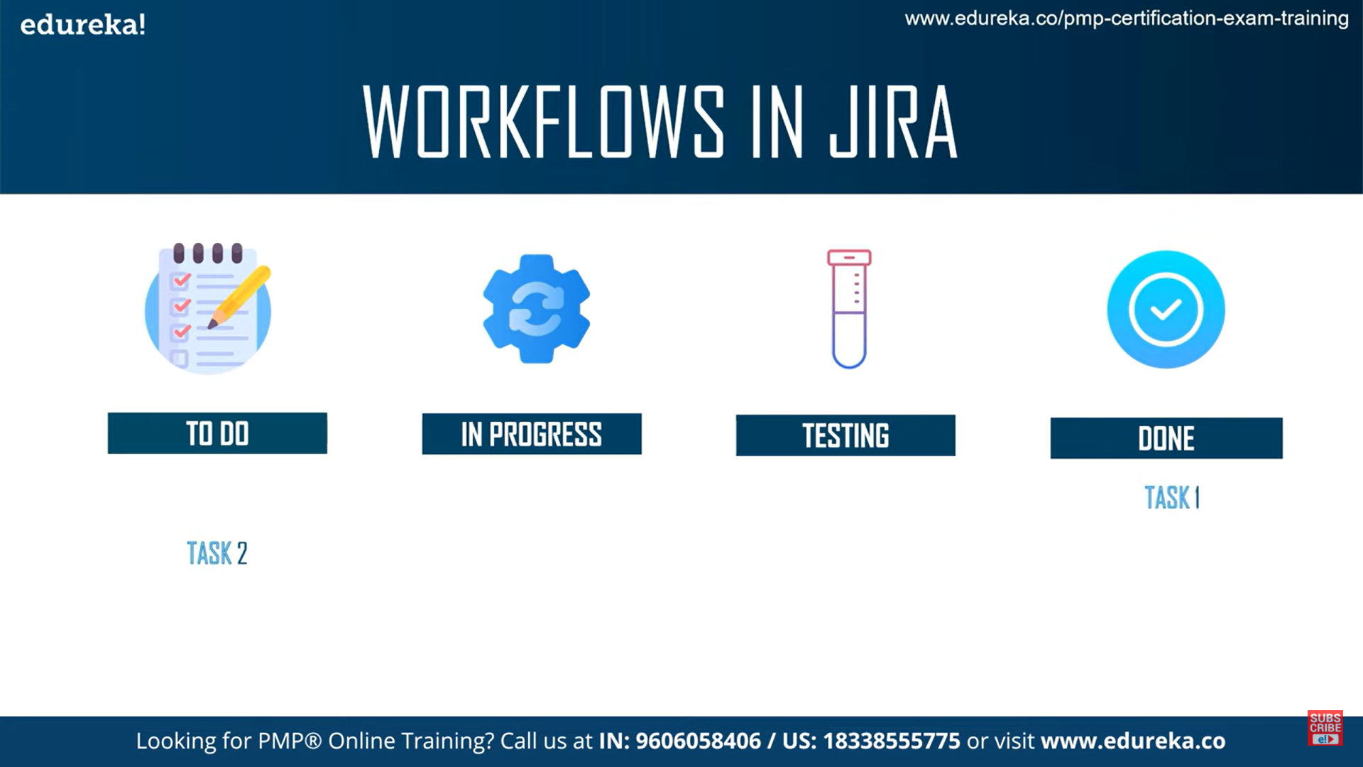
Steps and Workflows
Steps: Plan -> Collaborate -> Execute -> Document -> Evaluate
Work Flows:

Slide 25
Advantages
Getting Started:
To get started with Jira, users can sign up for a Jira Cloud or Jira Server instance, depending on their requirements.
Jira offers comprehensive documentation, tutorials, and training resources to help users learn how to use the platform effectively.
Users can also explore the Atlassian Marketplace to discover and install apps and integrations to further enhance Jira's functionality.
Benefits:
Improved Productivity
Enhanced Visibility
Scalability
Flexibility

Slide 26
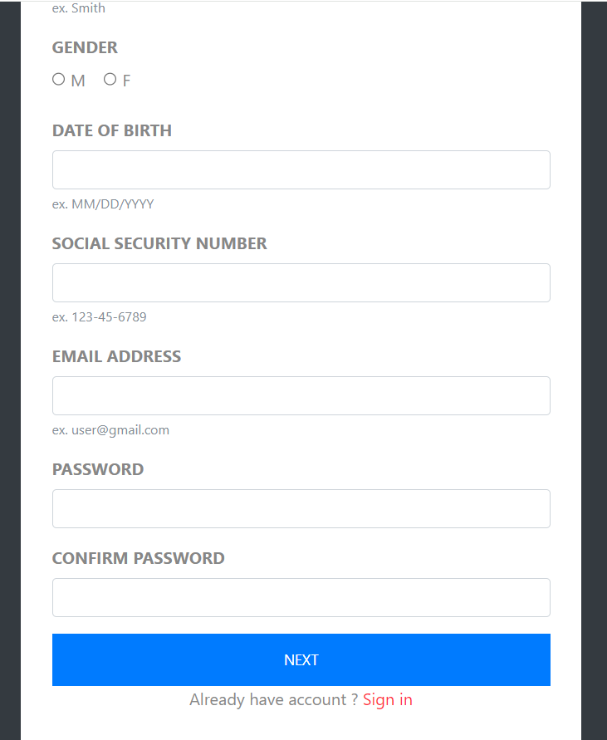
Module – Sign_Up (Test Cases)
User sign up with missing fields
User enters invalid DOB
User registers with existing mail
User enters mismatched passwords
User enters invalid information
User enters information correctly and then the account is created

Slide 27
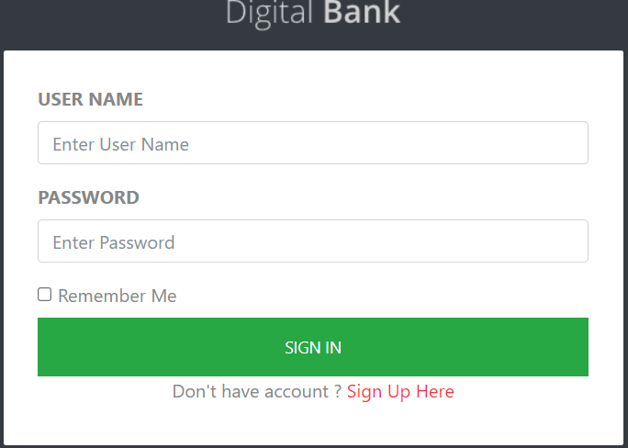
Module – Sign_in (Test Cases)
User Sign in with Valid Credentials
User Sign in with Invalid Username
User Sign in with Invalid Password

Slide 28
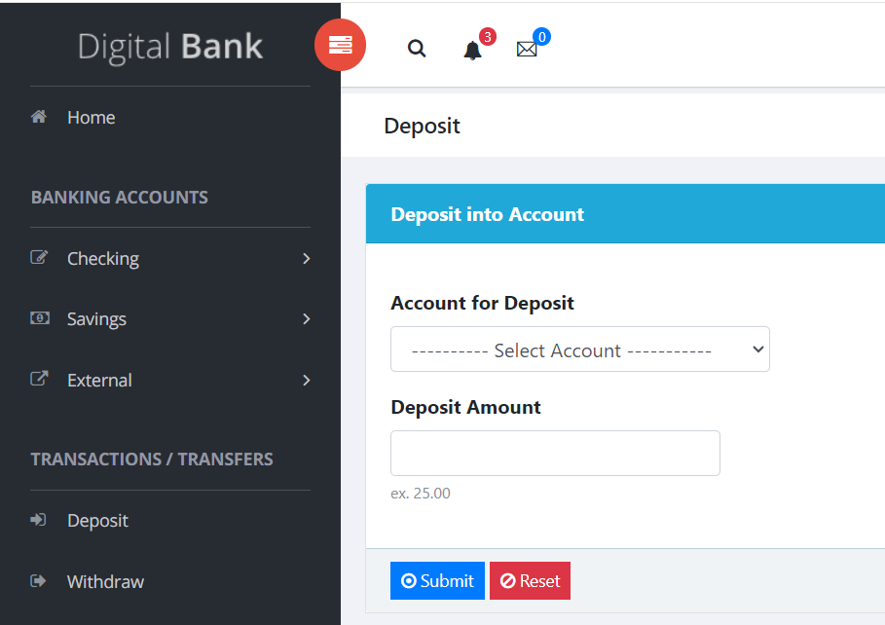
Module – Deposit (Test Cases)
To check Deposit to account fields with valid credentials(checking account)
To check deposit to account fields with amount field as zero
To check deposit to account fields with valid credentials(saving accounts)

Slide 29
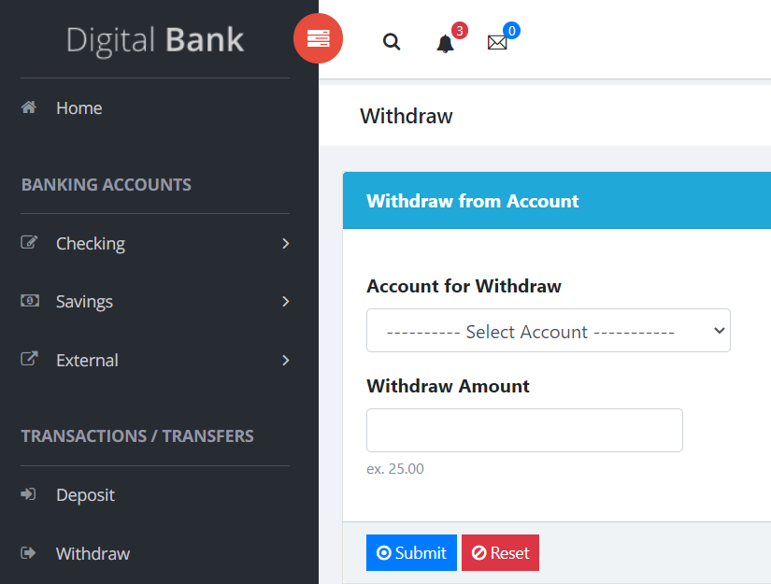
Module – Withdraw (Test Cases)
Click on the "Select Account" option and "Select saving account“
Click on the "Withdraw Amount input text area box" and enter Amount greater than balance amount in text area box and click submit
Click on the "Withdraw Amount input text area box" and leave the text area box empty and click submit

Slide 30
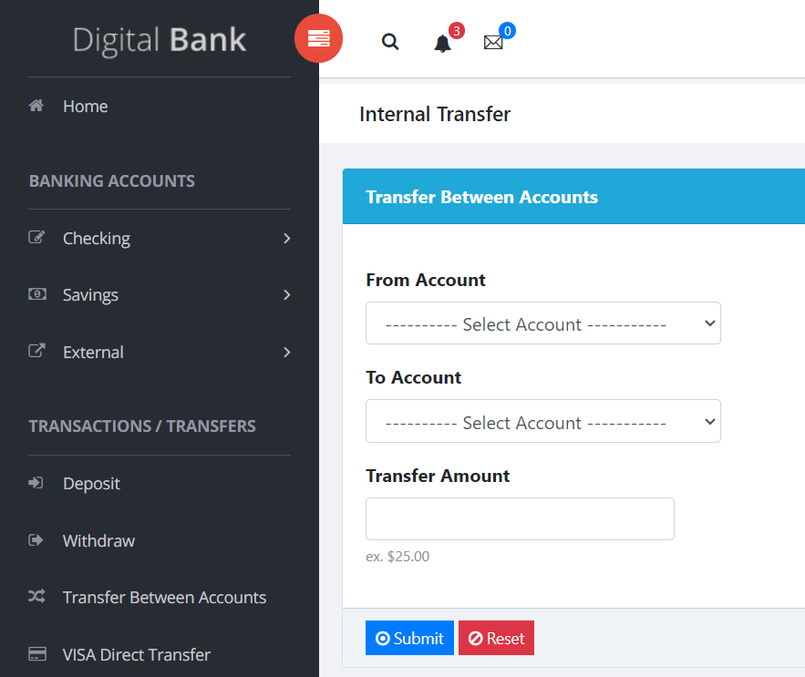
Module- Transfer (Test Cases)
Enter Valid From Account and To Account and available amount click on reset button
Enter Valid From Account and To Account and enter zero amount and click on submit button
Enter Valid From Account and To Account and zero amount

Slide 31
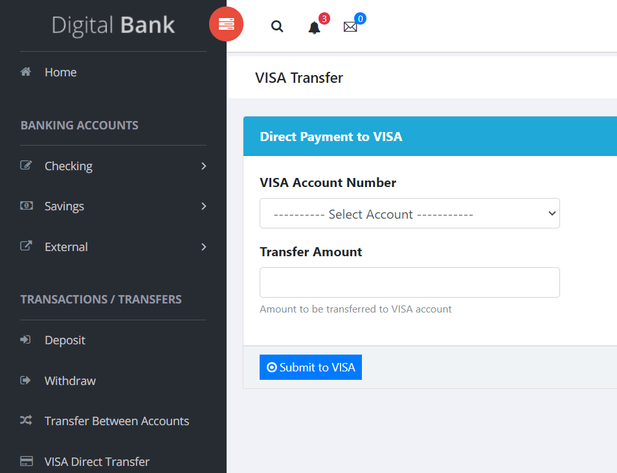
Module – Direct Payment to VISA(Test Cases)
User can access the account number and add amount

Slide 32
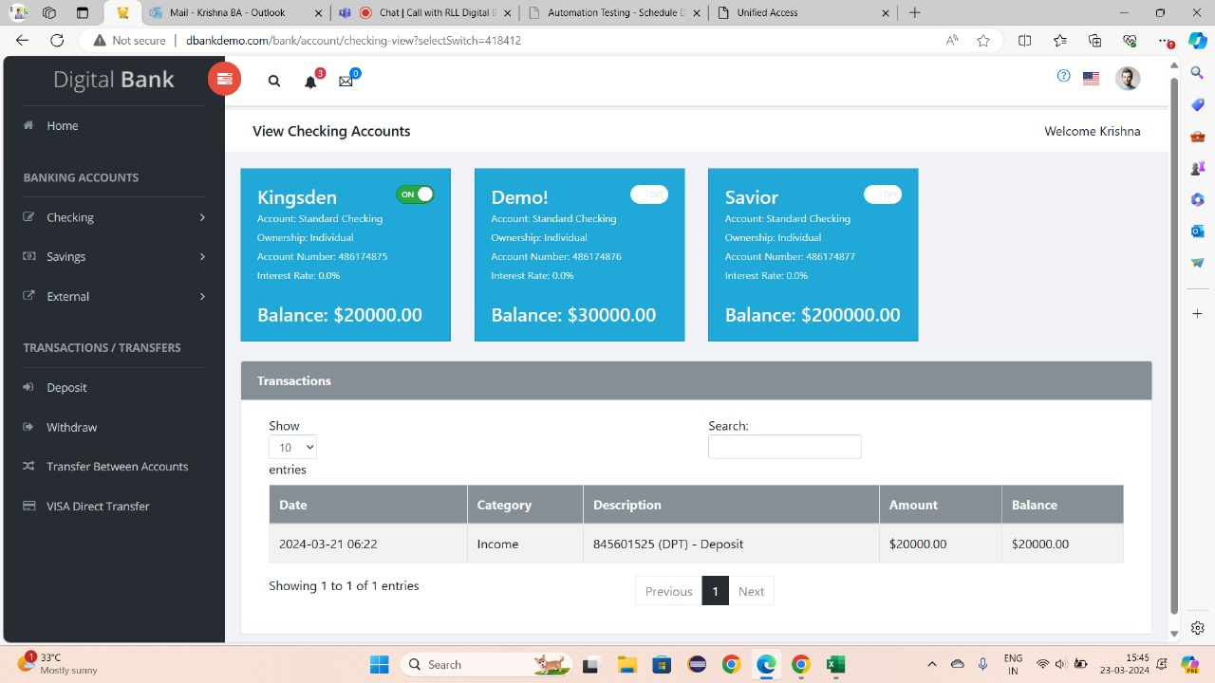
Module - Search By TRN no on View Checking (Test Cases)
User is Searching for correct TRN
User is Searching for incorrect TRN
User gives Empty TRN field
User Search TRN with Spaces

Slide 33
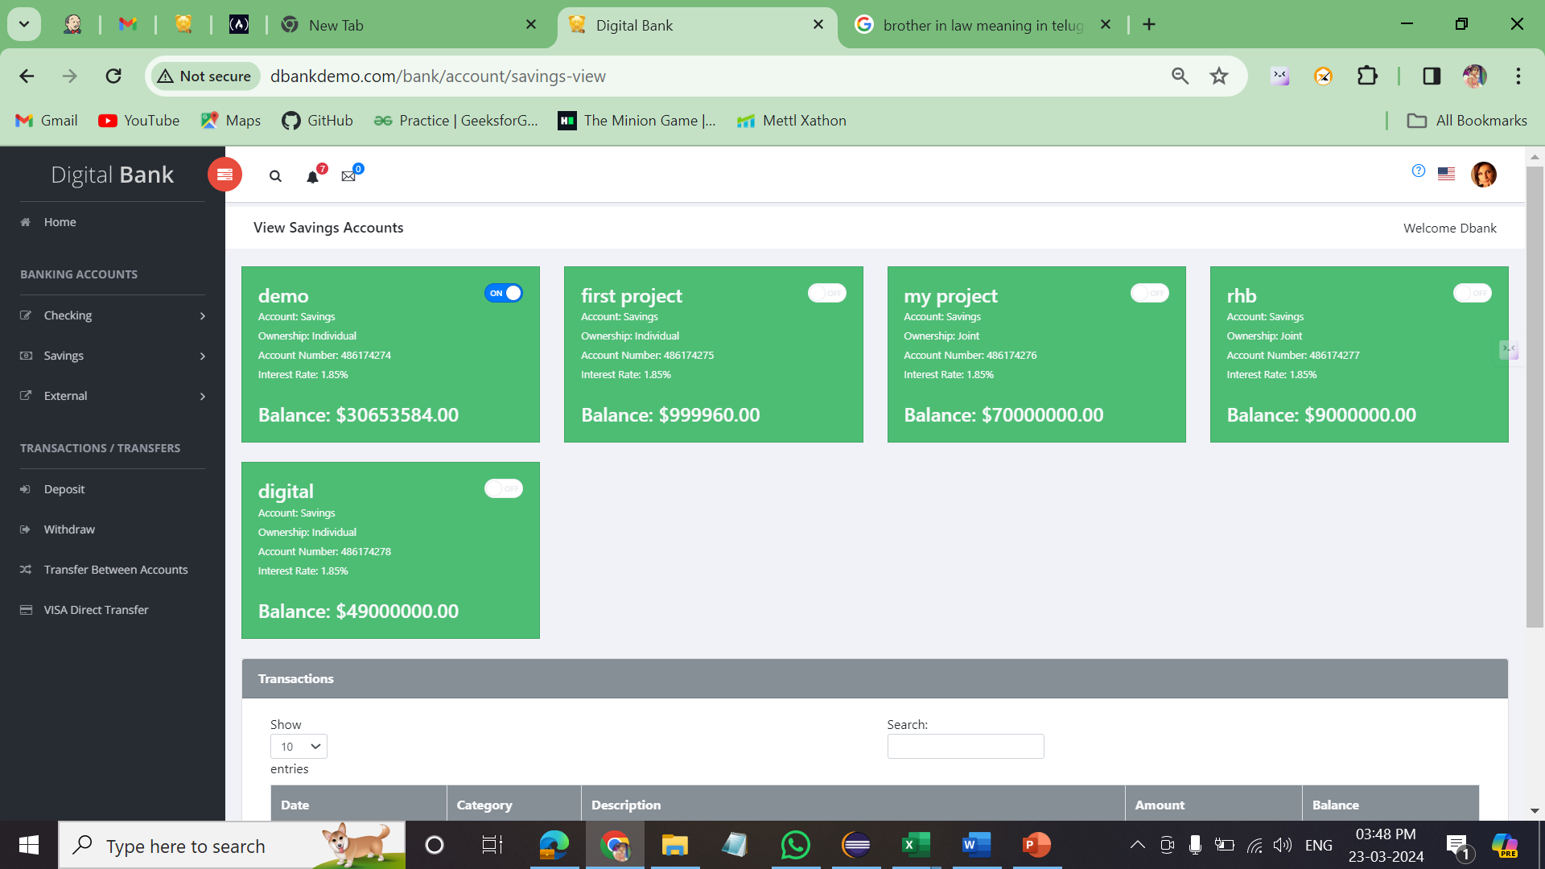
Module - Search by TRN no on View Savings Accounts(Test Cases)
Search for validate search box with amount
Search for search box with TRN
Search for search box with category
Search for search box with date

Slide 34

Extent Reports:
Definition: Extent Report is a reporting library that provides comprehensive and interactive HTML reports for test execution results. Importance: Offers detailed insights into test execution, including test pass/fail status, step-by-step logs, screenshots, etc., making it easier to analyse test results. Implementation: You can integrate Extent Report into your test automation framework by adding dependencies in your project, configuring Extent Reports instance, and logging test status, steps, and screenshots during test execution.

Slide 35
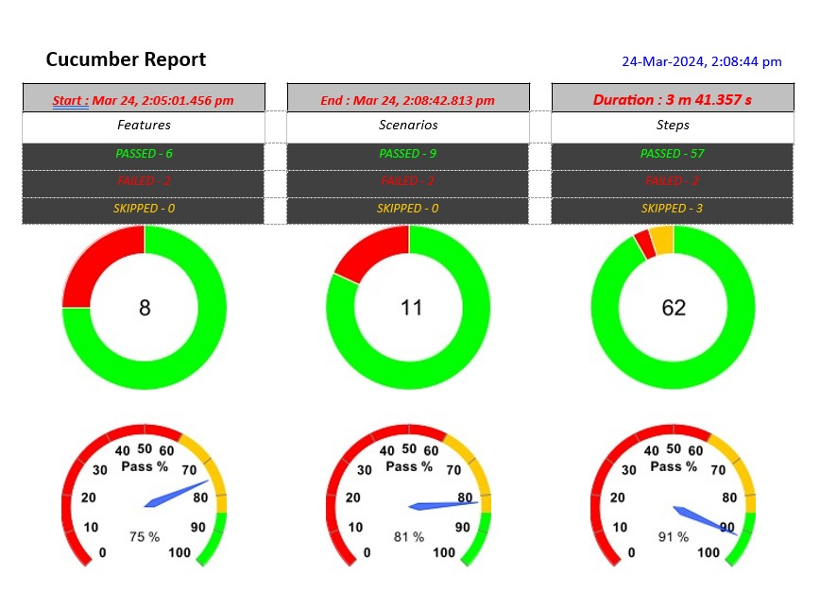

Slide 36
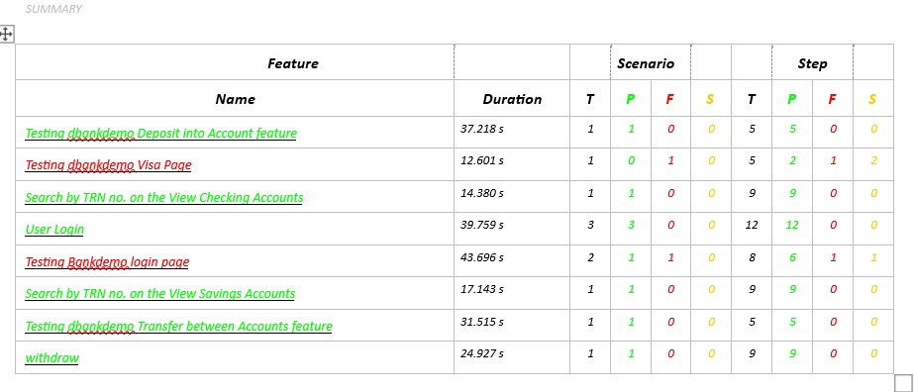

Slide 37
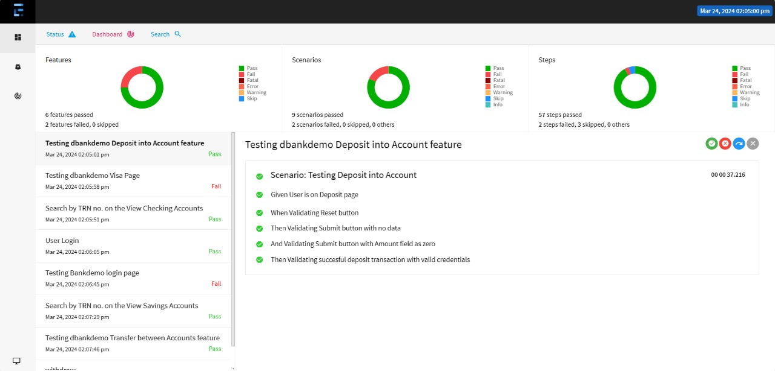

Slide 38
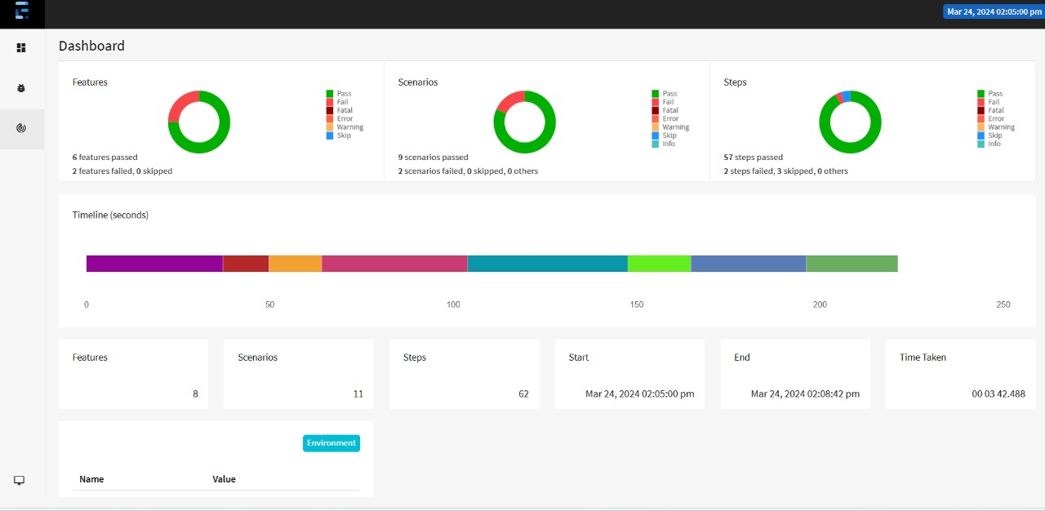

Slide 39
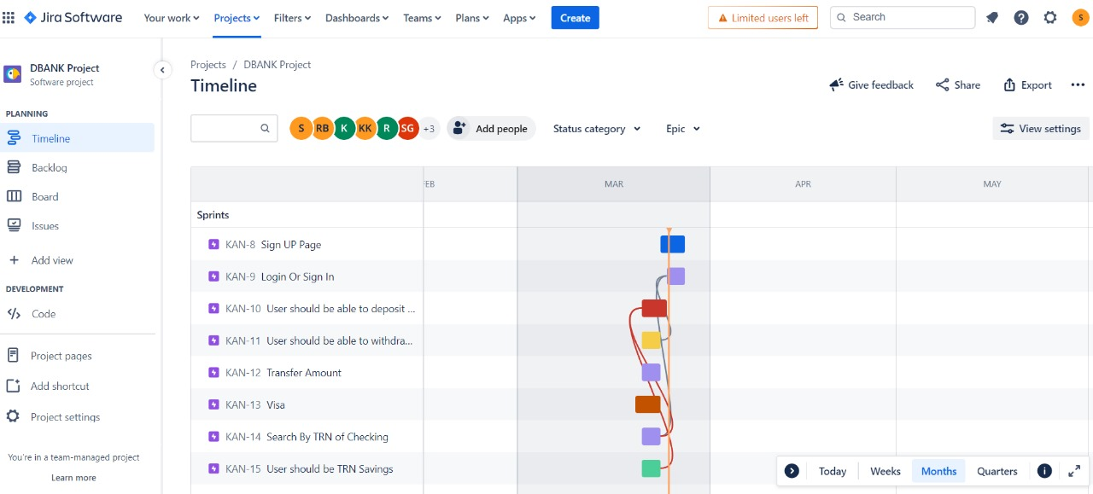
Jira is a popular project management tool developed by Atlassian, commonly used for issue tracking, bug tracking, and agile project management. It allows teams to plan, track, and manage software development projects efficiently. Jira provides features for creating and prioritizing tasks, assigning work to team members, tracking progress through workflows, and generating reports to analyze project metrics. It is widely used in software development teams to streamline collaboration and improve productivity.

Slide 40
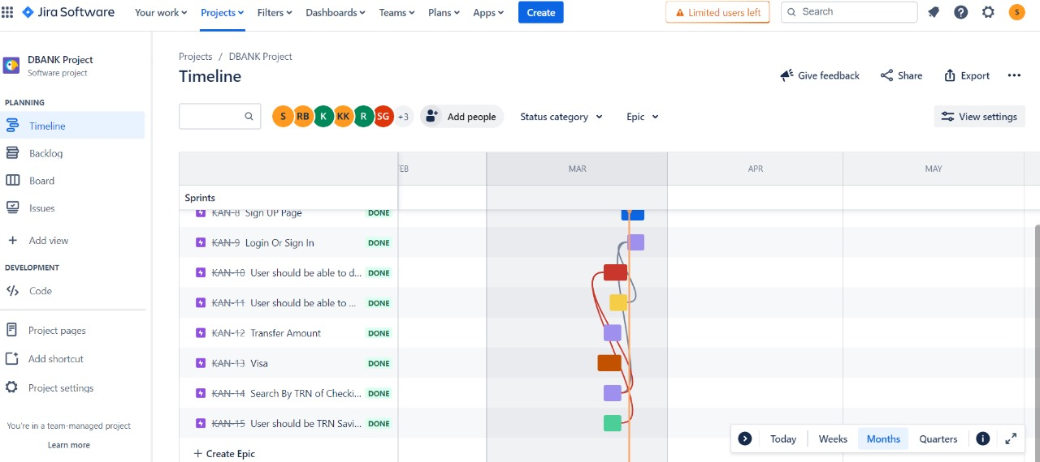
Sprint Completed:

Slide 41
Conclusion
In this project we learnt about different types of frameworks and dependencies we have to use, we have also seen about Iretry and Listeners and gone through different types of extent reports and how to work with JIRA. At last, I would like to thank the MLA team for giving me this opportunity, this has helped us to gain knowledge about testing and special thanks to Suvitha mam for the continuous support and guidance when we had problems/doubts while doing the project.

Slide 42
Thank YOU

